Slide 1

MACHINE LEARNING
Summer Internship- 2026
Name: Chetna Saharan
Supervisor: Prof. Millie Pant
Mentor: Ms. Riya & Mr. Harjeet Singh Applied Mathematics & Scientific Computing
Indian Institute of Technology Roorkee

Slide 2

TABLE OF CONTENT
INTRODUCTION TO MACHINE LEARNING
DATA PREPROCESSING AND EDA
LINEAR AND LOGISTIC REGRESSION
DECISION TREES AND RANDOM FORESTS
SVM AND K-NEAREST NEIGHBORS
CLUSTERING AND DIMENSIONALITY REDUCTION
MODEL EVALUATION AND HYPERPARAMETER TUNING
FEATURE ENGINEERING AND PIPELINES
INTRODUCTION TO NLP
MACHINE LEARNING CAPSTONE

Slide 3
INTRODUCTION TO MACHINE LRARNING
MACHINE LEARNING: ML is the process of training a piece of software, called a model, to make useful predictions
or generate content (like text, images, audio, or video) from data.
Machine learning (ML) powers some of the most important technologies we use, from
translation apps to autonomous vehicles.
ML algorithms identify patterns in historical data and use those patterns to make predictions
or decisions on new data.
EXAMPLE: Real-Life Applications of ML
Netflix & YouTube: Recommend movies and videos.
Amazon & Flipkart: Recommend products based on previous purchases.
Healthcare: Predict diseases from medical reports.
How It Works: Traditional Programming vs. Machine Learning
Traditional Programming: You input Data and Rules (code) into a computer to get an Answer.
Machine Learning: You input Data and Answers (labeled examples) into a computer, and it outputs
the Rules (the model).

Slide 4
INTRODUCTION TO MACHINE LEARNING
The Core Types of Machine Learning
Machine learning is generally broken down into three main categories based on how the algorithm learns:
Supervised Learning: The algorithm is trained on "labeled" data, meaning the input data already has the correct answer attached to it.
Example: Teaching a system to recognize tumors by showing it thousands of MRI scans labeled "benign" or "malignant."
Unsupervised Learning: The algorithm is given "unlabeled" data and must find patterns, structures, or anomalies on its own.
Example: Grouping e-commerce customers into distinct segments based on their purchasing habits for targeted marketing.
Reinforcement Learning: The algorithm learns by trial and error within a specific environment, receiving "rewards" for correct actions and "penalties" for wrong ones.
Example:
A robot learns to navigate a maze by receiving rewards for reaching the exit and penalties for hitting walls.

Slide 5
INTRODUCTION TO MACHINE LEARNING
Key Terminology in Machine Learning
Features Features are input variables used by an ML model to make predictions. Examples: house area, bedrooms, attendance.
Labels Labels are the correct outputs (target values) the model learns to predict. Examples: house price, Spam/Not Spam.
Training Training is the process of teaching a model using historical data. The model learns patterns between features and labels. Example: Training a spam filter using thousands of labeled emails.
Testing Testing evaluates the trained model on unseen data to measure accuracy and generalization. Example: Testing the spam filter on new emails.

Slide 6
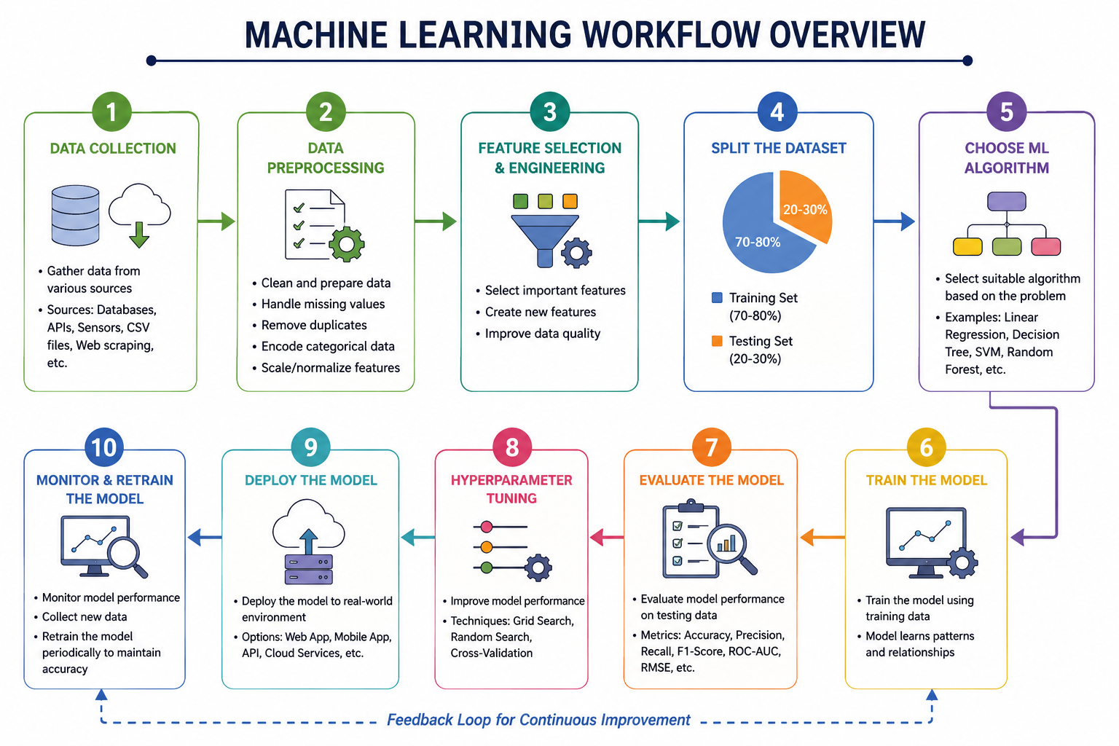
INTRODUCTION TO MACHINE LEARING

Slide 7
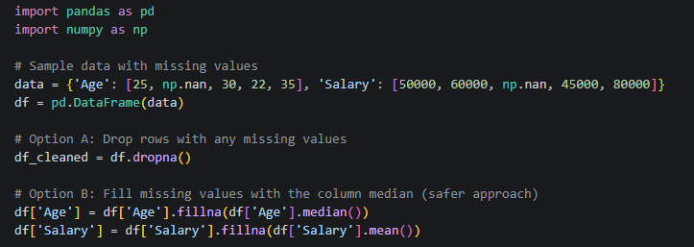
Data preprocessing and EDA
Handling Missing Values
Real-world data is messy and often contains blanks (NaNs). If you pass missing values into a machine learning model, it will throw an error.
dropna(): Deletes rows or columns that contain missing data. Use this if the missing data is minimal and losing a few rows won’t hurt your dataset.
fillna(): Replaces missing values with a specific substitute, like a fixed number, the mean, median, or mode of that column.
Example:

Slide 8
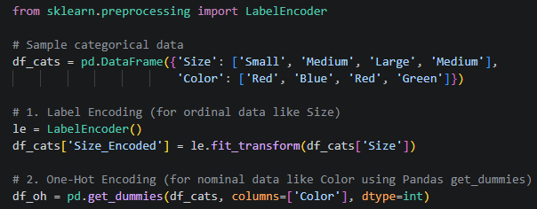
DATA PREPROCESSING AND EDA
Encoding Categorical Variables
Machine learning models are just massive calculators; they only understand numbers, not text. Categorical data (like "Red", "Blue", or "Low", "Medium", "High") must be converted into numerical formats.
LabelEncoder: Assigns a unique integer to each category (e.g., Low = 0, Medium = 1, High = 2).
Best for: Ordinal data where the categories have a natural mathematical order.
OneHotEncoder: Creates a new binary column
(0 or 1) for each unique category.
Best for: Nominal data where there is no inherent order (e.g., Country: USA, India, Germany). This prevents the model from mistakenly thinking Germany (2) is "greater than" USA (0).
Example:

Slide 9
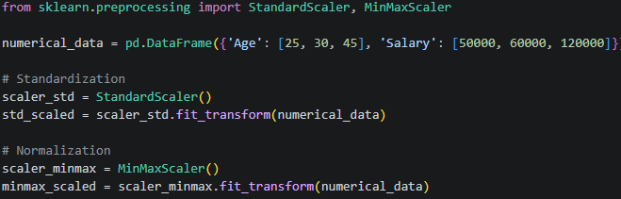
DATA PREPROCESSING AND EDA
Feature scaling:
When your dataset features have wildly different ranges (e.g., Age ranges from 0 to 100, while Salary ranges from $20,000 to $200,000), algorithms that rely on distances can get warped. Scaling brings them to a level playing field.
StandardScaler (Standardization): Centers the data around a mean of 0 with a standard deviation of 1. It transforms data into a standard normal distribution.
Best for: Most algorithms (especially Linear Regression, Logistic Regression, SVMs) and handles outliers relatively well.
MinMaxScaler (Normalization): Rescales the data so all values fall strictly between 0 and 1.
Best for: Neural networks or algorithms where you specifically need bounded intervals, but it is highly sensitive to outliers.
Example:

Slide 10
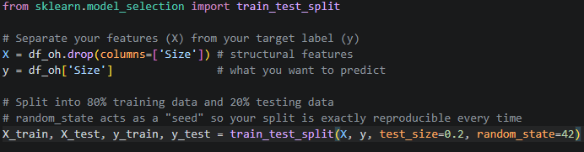
DATA PREPROCESSING AND EDA
.
Train-Test Split
As we discussed earlier, you never want your model to take its final exam using the exact same questions it studied. You split your data to evaluate it fairly.
Using train_test_split from sklearn, you shuffle and cut your features ($X$) and labels ($y$) simultaneously.
Example:

Slide 11
DATA PREPROCESSING AND EDA
Exploratory Data Analysis (EDA) with Seaborn/Matplotlib
Before writing a single line of machine learning code, you must look at your data visually to check for trends, outliers, and correlations.
Matplotlib is the foundational, low-level plotting engine.
Seaborn is built on top of Matplotlib and makes beautiful, complex statistical plots with very little code.
A. Distribution Plot (Histogram)
Used to see the spread and skewness of a single continuous variable.
B. Scatter Plot
Used to see the relationship between two continuous variables and find potential clusters or linear trends.
C. Correlation Heatmap
Used to check the linear relationship between all numerical variables simultaneously. Values closer to 1 or -1 indicate a strong correlation, which helps you identify which features might be strong predictors for your target label.

Slide 12

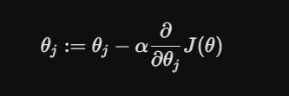
LINEAR AND LOGISTIC REGRESSION
Linear Regression is used to predict a continuous numeric value (like housing prices or stock trends) by
fitting a straight line to the data points
Linear Regression
The Cost Function
To find the best-fitting line, we need to measure how "wrong" our model's predictions are. We use the Mean Squared Error (MSE) as the cost function, often denoted as $J(\theta)$.
Gradient Descent
Gradient Descent is the optimization algorithm used to minimize the cost function. It calculates the gradient (slope) of the cost function and takes small steps downward until it reaches the minimum error.

Slide 13




LINEAR AND LOGISTIC REGRESSION
Regression Metrics
1. Mean Squared Error (MSE)
Measures the average squared difference between
actual and predicted values.
Formula:
To evaluate how well a Linear Regression model is performing, we measure the distance between the predicted values (X) and the actual values (y).
3.R² Score (Coefficient of Determination)
Measures how well the regression model explains the variation in the data.
Formula:
4. Accuracy
Percentage of correctly classified instances.
Formula:
2. Root Mean Squared Error (RMSE)
Square root of MSE.
Formula:

Slide 14


LINEAR AND LOGISTIC REGRESSION
1. Plotting a Regression Line (Linear Regression)
A regression line visualizes the relationship between a continuous independent variable (x) and a dependent variable (y).
The Steps:
1.Scatter the Data: Plot the actual data points from your dataset using their (x, y) coordinates.
2.Find the Line Equation: Once the model is trained, it outputs two primary coefficients: the slope (m or theta) and the y-intercept (c or theta). This gives you the standard line equation:
y = mx + c
3.Generate Prediction Points: To draw a perfectly straight line, you only need two points, but typically you take the minimum and maximum x values from your dataset.
4.Calculate y for those x values: Plugin the min and max x values into your model to get the predicted hat{y} values.
Draw the Line: Plot a solid line connecting those predicted coordinates directly over your scatter plot.
2. Plotting a Decision Boundary (Logistic Regression)
A decision boundary visualizes how a classifier splits data into distinct classes (e.g., Class 0 vs. Class 1). Since we usually work with two features (x1 and x2) to plot this on a 2D plane, the boundary is the exact line where the probability of belonging to either class is exactly 50% (p = 0.5).
The Steps:
Scatter the Data: Plot your data points using x1 on the horizontal axis and x2 on the vertical axis. Color-code the points based on their true class (e.g., Blue for 0, Red for 1).
Set the Boundary Equation: The underlying linear equation for logistic regression is:
3.Solve for x2: To plot this as a standard y = mx + c line where x2 acts as our "y-axis", rearrange the equation:
4.Plot the Boundary Line: Generate a range of x1 values, calculate the corresponding x2 values using the formula above, and draw the resulting straight line. Everything on one side of this line will be predicted as Class 0, and everything on the other side as Class 1.

Slide 15
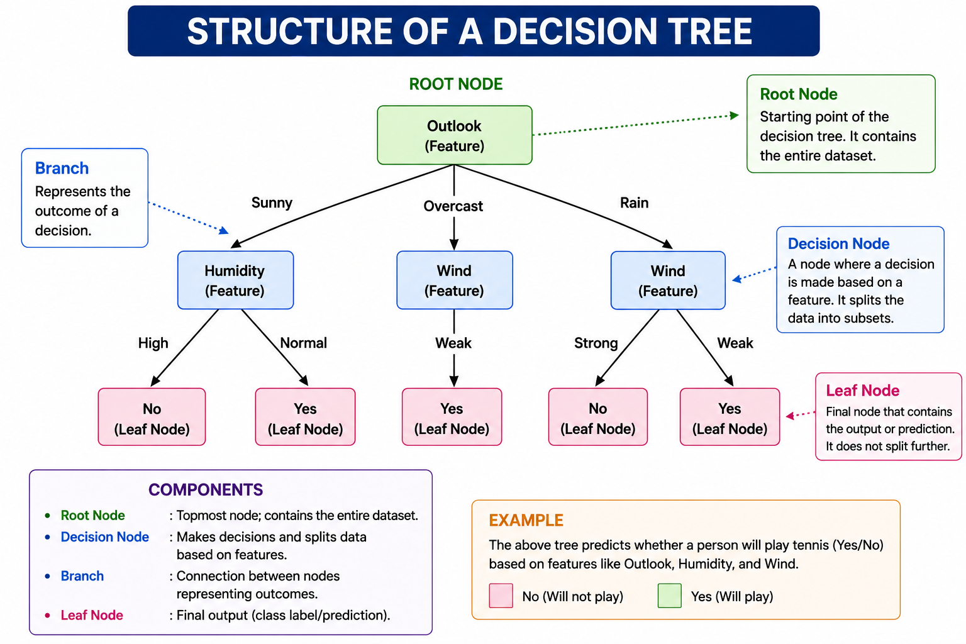
Decision trees & random forests
Decision Trees: Mathematical Formulations of Splitting Criteria
Decision trees are non-parametric supervised learning models that partition the feature space into local regions through a sequence of recursive binary splits. The core objective at each node is to select a feature X_{j} and a corresponding threshold t that maximizes the homogeneity of the resulting child nodes. Three primary metrics govern this selection process: Gini Impurity, Entropy, and Information Gain.

Slide 16

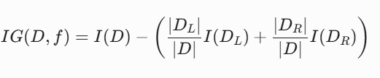

DECISION TREES & RANDOM FORESTS
Gini Impurity measures the probability of a randomly chosen element from a node being incorrectly labeled if it were randomly labeled according to the distribution of labels in the subset.
For a discrete probability distribution at node m with K classes, where pk represents the proportion of instances belonging to class k, the Gini impurity Ig(m) is mathematically defined as:
Entropy rooted in Shannon’s Information Theory, Entropy quantifies the average level of "information," surprise, or uncertainty inherent in the node's class distribution. For a node $m$, the entropy I_E(m) is formulated as:
Information Gain (IG) is the operational metric used to decide which feature split to execute. It measures the expected reduction in impurity or entropy after partitioning the data based on an attribute. Given a parent node $D$ and a split candidate that divides $D$ into a left child $D_L$ and a right child $D_R$, the Information Gain is computed as:
When a node is completely homogeneous (pk = 1 for some k), entropy equals 0. Conversely, if classes are perfectly balanced (pk = 1/K), entropy reaches its theoretical maximum of log2(K).
Where:
I(.) represents either Gini Impurity or Entropy.
|D|, |D_L|, and |D_R| denote the number of samples in the parent, left child, and right child nodes, respectively.
The algorithm greedily scans all available features and thresholds to select the split that yields the maximum IG.
Gini impurity ranges from 0 (perfect purity, where all instances belong to a single class) to 1 - 1/K (uniform distribution across all classes). Computationally, Gini is favored over entropy because it avoids the costly evaluation of logarithmic functions.

Slide 17
DECISION TREES & RANDOM FORESTS
What is Overfitting?
Overfitting occurs when a Decision Tree learns the training data too well, including noise and outliers. As a result, it performs very well on the training data but poorly on new, unseen data.
Characteristics of Overfitting
Very high training accuracy
Low testing accuracy
Deep and complex tree
Poor generalization to new data
Causes
Tree grows without restrictions.
Too many branches and leaf nodes.
Small training dataset.
Learning noise instead of actual patterns
Tree Pruning
Tree pruning is the process of removing unnecessary branches from a Decision Tree to reduce complexity and improve prediction accuracy.
Types of Tree Pruning
1. Pre-Pruning (Early Stopping)
Stops the tree from growing before it becomes too complex.
Common parameters:
max_depth
min_samples_split
min_samples_leaf
2. Post-Pruning
Grow the complete tree.
Remove branches that contribute little to prediction accuracy.
max_depth Parameter
max_depth defines the maximum depth (number of levels) of a Decision Tree
.
Small max_depth | Large max_depth
Simple tree | Complex tree
Less overfitting | Higher overfitting
Better generalization | May memorize data
Faster training | Slower training

Slide 18
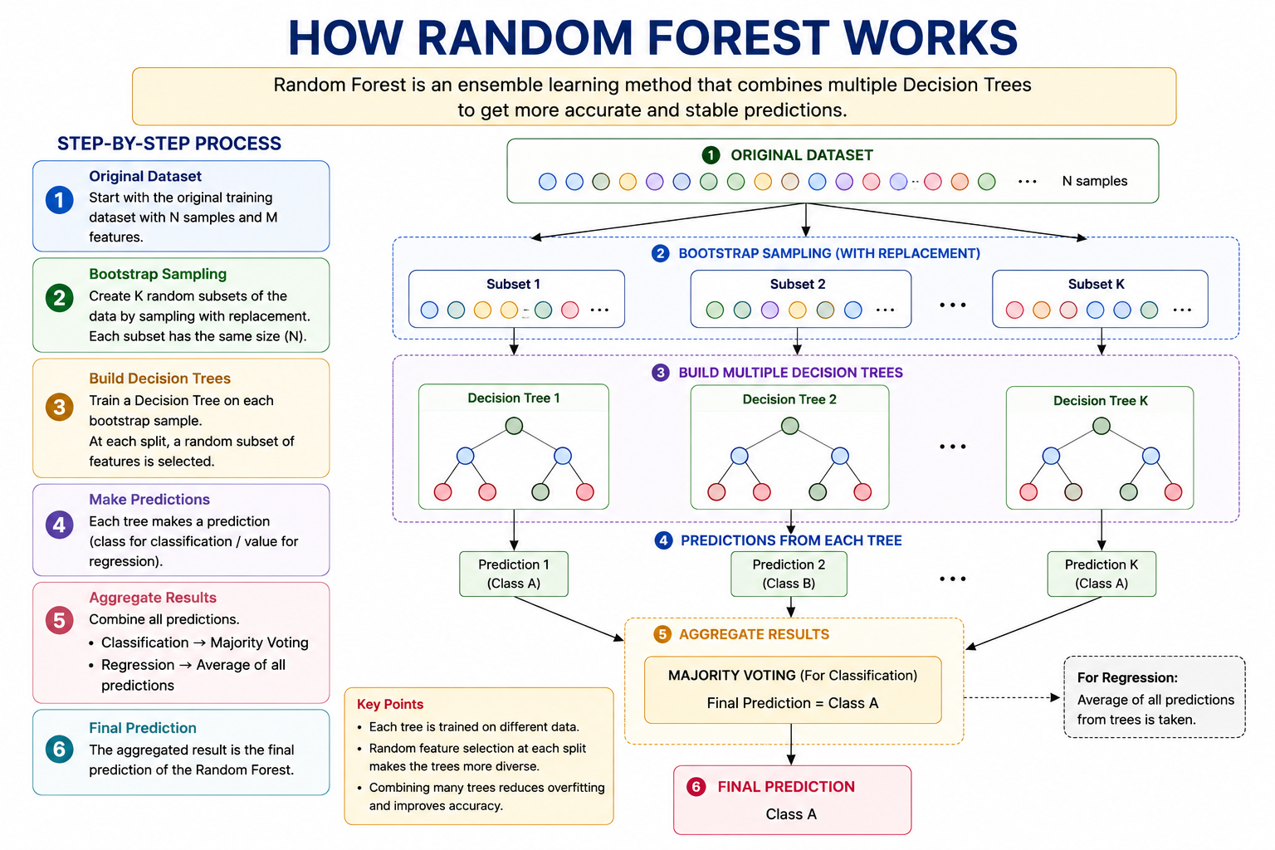
DECISION TREES & RANDOM FORESTS
What is Random Forest?
Random Forest is a supervised ensemble machine learning algorithm used for both classification and regression tasks. It combines multiple Decision Trees to produce more accurate and reliable predictions than a single Decision Tree.

Slide 19
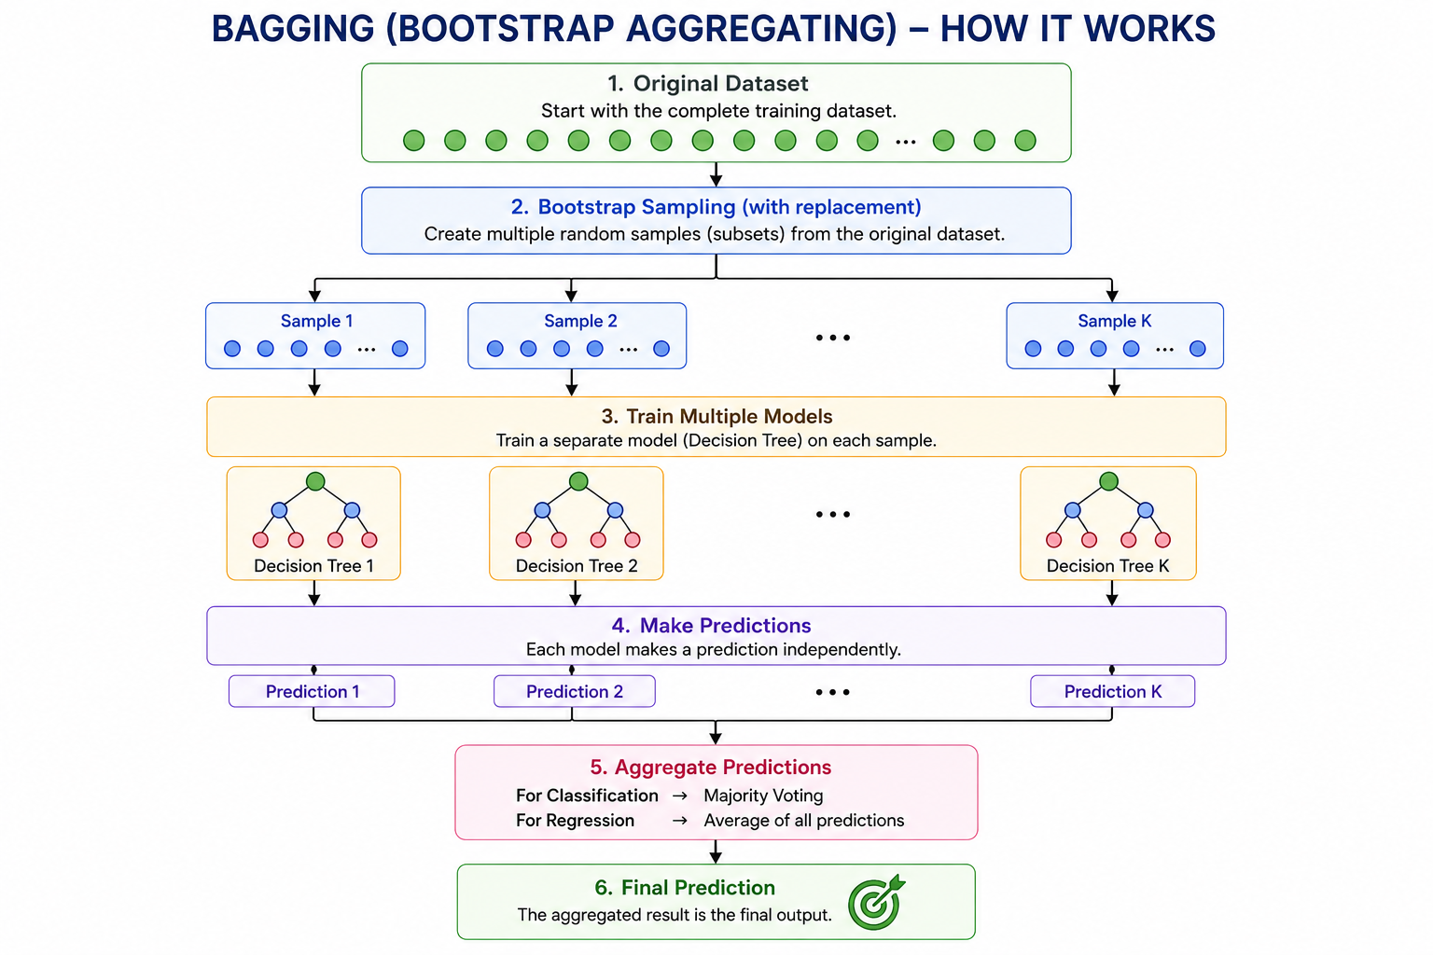
DECISION TREES & RANDOM FORESTS
What is Bagging?
Bagging (Bootstrap Aggregating) is an ensemble learning technique used to improve the accuracy and stability of machine learning models. It is the main technique behind Random Forest.
Instead of training one Decision Tree, bagging trains multiple Decision Trees on different random subsets of the training data and combines their predictions.

Slide 20
SVM & K-NEAREST NEIGHBORS
What is Support Vector Machine (SVM)?
Key Concepts
1. Hyperplane
A hyperplane is the decision boundary that separates different classes.
In 2D, it is a line.
In 3D, it is a plane.
In higher dimensions, it is called a hyperplane.
2. Margin
Margin is the distance between the hyperplane and the nearest data points.
SVM chooses the hyperplane with the largest margin because it improves generalization and reduces classification errors.
Support Vector Machine (SVM) is a supervised machine learning algorithm used for classification and regression. Its main objective is to find the best boundary (hyperplane) that separates different classes with the maximum margin.
3. Support Vectors
Support vectors are the closest data points to the hyperplane.
They determine the position and orientation of the hyperplane.
Removing other data points usually does not change the decision boundary, but changing support vectors does.
4. Kernel Trick
When the data is not linearly separable, SVM uses the Kernel Trick to transform the data into a higher-dimensional space where it can be separated.
Common Kernel Functions
Linear Kernel – For linearly separable data.
Polynomial Kernel – Creates curved decision boundaries.
RBF (Gaussian) Kernel – Handles complex non-linear data.
Sigmoid Kernel – Similar to neural network activation functions.

Slide 21



SVM & K-NEAREST NEIGHBORS
What is KNN?
K-Nearest Neighbors (KNN) is a supervised learning algorithm used for classification and regression. It predicts the class of a new data point by looking at the K nearest neighbors.
Working of KNN
Choose the value of K.
Calculate the distance between the new point and all training points.
Select the K nearest neighbors.
Use majority voting (classification) or average (regression).
Predict the output.
Choosing the Value of K
Small K (1–3)
Sensitive to noise.
High variance.
May overfit.
Large K (10–20)
Smoother decision boundary.
Lower variance.
May underfit.
Rule of Thumb:
​
where N is the number of training samples.
Distance Metrics
1. Euclidean Distance
Most commonly used for continuous numerical data.
2. Manhattan Distance
Useful when movement is restricted to horizontal and vertical directions.
3. Minkowski Distance
A generalized distance metric that includes Euclidean and Manhattan distances as special cases.

Slide 22
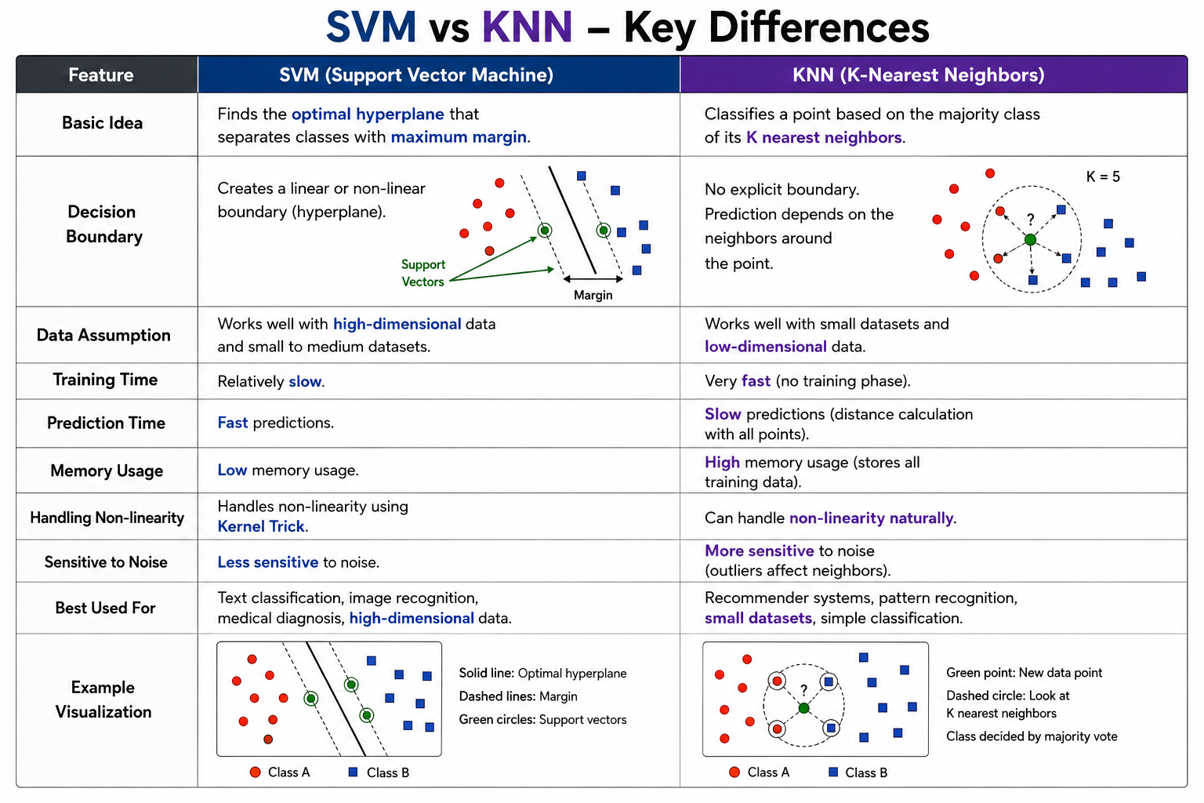

Slide 23
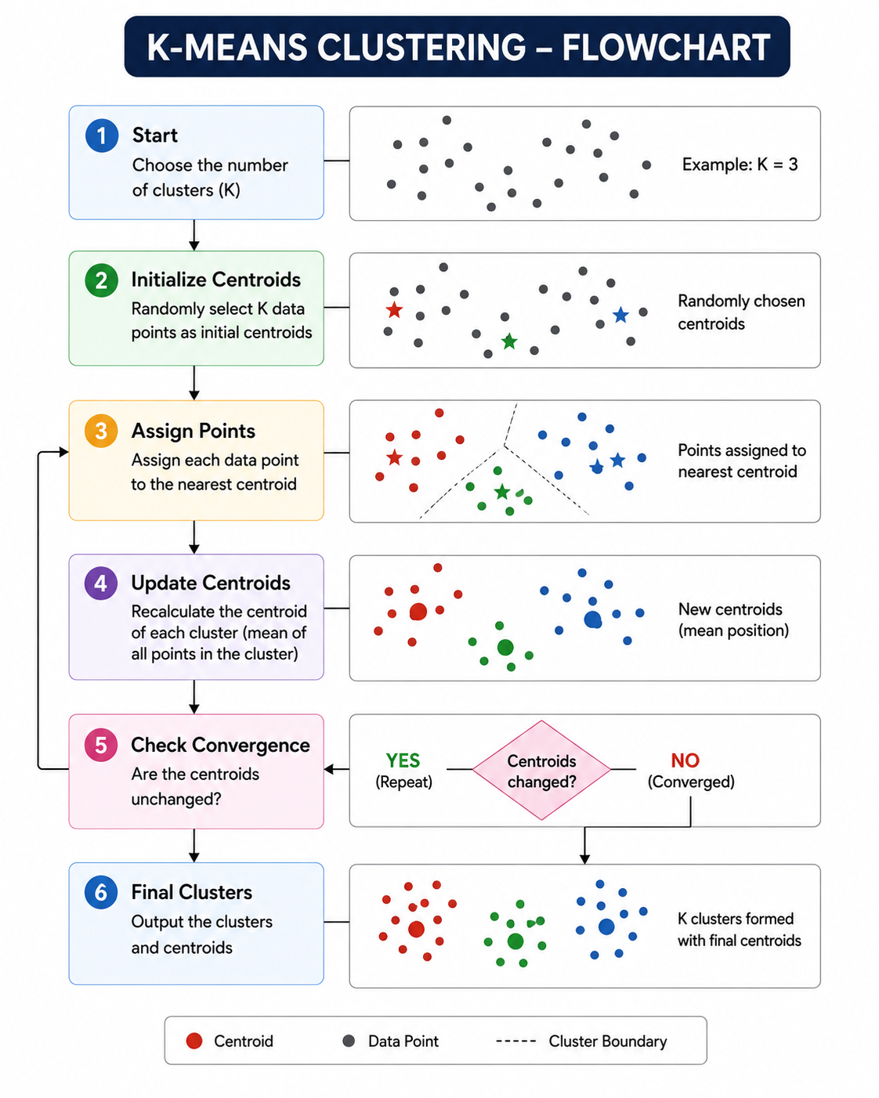
CLUSTERING & DIMENSIONALITY REDUCTION
What is K-Means Clustering?
K-Means Clustering is an unsupervised machine learning algorithm that groups similar data points into K clusters. The algorithm minimizes the distance between data points and the center of their assigned cluster.
Working of K-Means Algorithm
Choose the number of clusters (K).
Initialize K centroids randomly.
Assign each data point to the nearest centroid.
Recalculate the centroid by taking the mean of all points in each cluster.
Repeat Steps 3 and 4 until the centroids stop changing (convergence).
1. Centroids
A centroid is the center point of a cluster. It is calculated as the mean of all data points in that cluster.
2. Inertia
Inertia measures the sum of squared distances between each data point and its nearest centroid.
3. Elbow Method
The Elbow Method helps determine the optimal value of K.

Slide 24
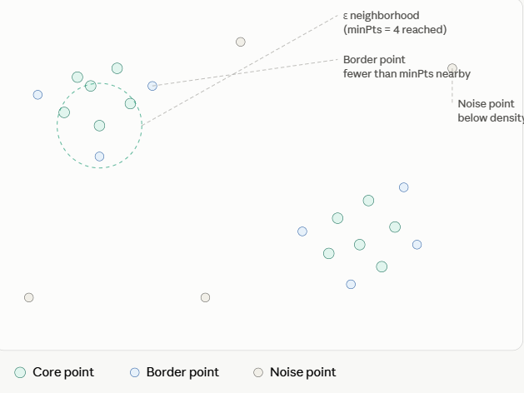
CLUSTERING & DIMENSIONALITY REDUCTION
DBSCAN overview
What is DBSCAN?
DBSCAN is an unsupervised machine learning clustering algorithm that groups together data points that are closely packed (high-density regions) and identifies points in low-density regions as outliers (noise).
Unlike K-Means, DBSCAN does not require the number of clusters (K) to be specified in advance.
Key Concepts
1. Epsilon (ε)
The maximum distance between two data points to be considered neighbors.
Determines the size of the neighborhood around a point.
2. MinPts (Minimum Points)
The minimum number of neighboring points required to form a dense region (cluster).
3. Core Point
A point that has at least MinPts neighbors within the ε radius.
4. Border Point
A point that is within the ε neighborhood of a core point but has fewer than MinPts neighbors.
5. Noise (Outlier)
A point that is neither a core point nor a border point.
It does not belong to any cluster.

Slide 25
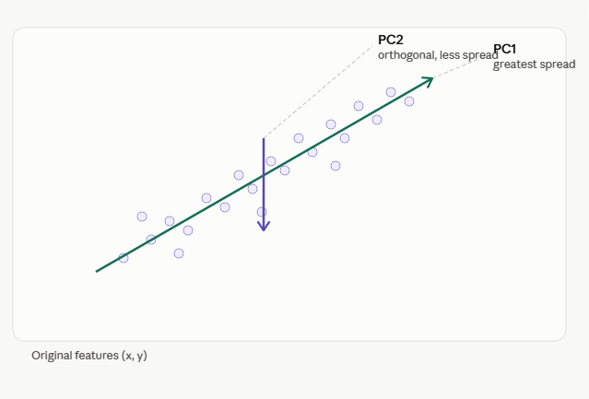
CLUSTERING & DIMENSIONALITY REDUCTION
What is PCA?
Principal Component Analysis (PCA) is an unsupervised dimensionality reduction technique used to reduce the number of features in a dataset while preserving as much information (variance) as possible.
PCA transforms the original correlated variables into a new set of uncorrelated variables called Principal Components (PCs).
Principal Components (PCs)
Principal Components are new axes formed by combining the original features.
PC1 (First Principal Component):
Captures the maximum variance in the dataset.
Most informative component.
PC2 (Second Principal Component):
Captures the next highest variance.
Perpendicular (orthogonal) to PC1.
PC3, PC4, ...
Capture the remaining variance.
Principal components are new axes that PCA constructs from the original features — each one a linear combination of all the original variables. PC1 is chosen to point in the direction of greatest variance in the data (the long axis of the cloud above); PC2 is then chosen orthogonal to PC1, capturing the largest remaining variance, and so on for as many components as there are original dimensions. Because the components are orthogonal, they're uncorrelated with each other even when the original features were highly correlated.

Slide 26
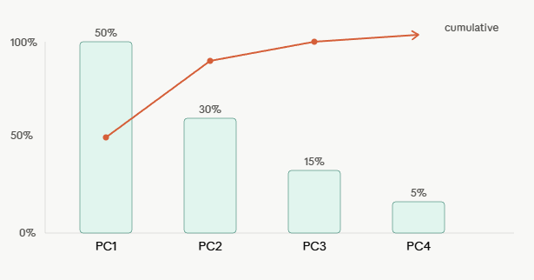
CLUSTERING & DIMENSIONALITY REDUCTION
Explained Variance
Explained Variance tells us how much information (variance) each principal component retains from the original dataset.
Explained variance tells you how much of the original dataset's total variance each component accounts for. It's computed from the eigenvalues of the covariance matrix: the eigenvalue for a component, divided by the sum of all eigenvalues, gives that component's share. In the scree plot above, PC1 alone captures 50% of the variance, PC2 another 30%, and the remaining components trail off — a classic "elbow" shape. The cumulative line (in orange) shows that the first two or three components already explain the large majority of the variance, which is the basis for dimensionality reduction: keep enough components to retain, say, 90–95% of cumulative variance, and discard the rest with minimal information loss.

Slide 27
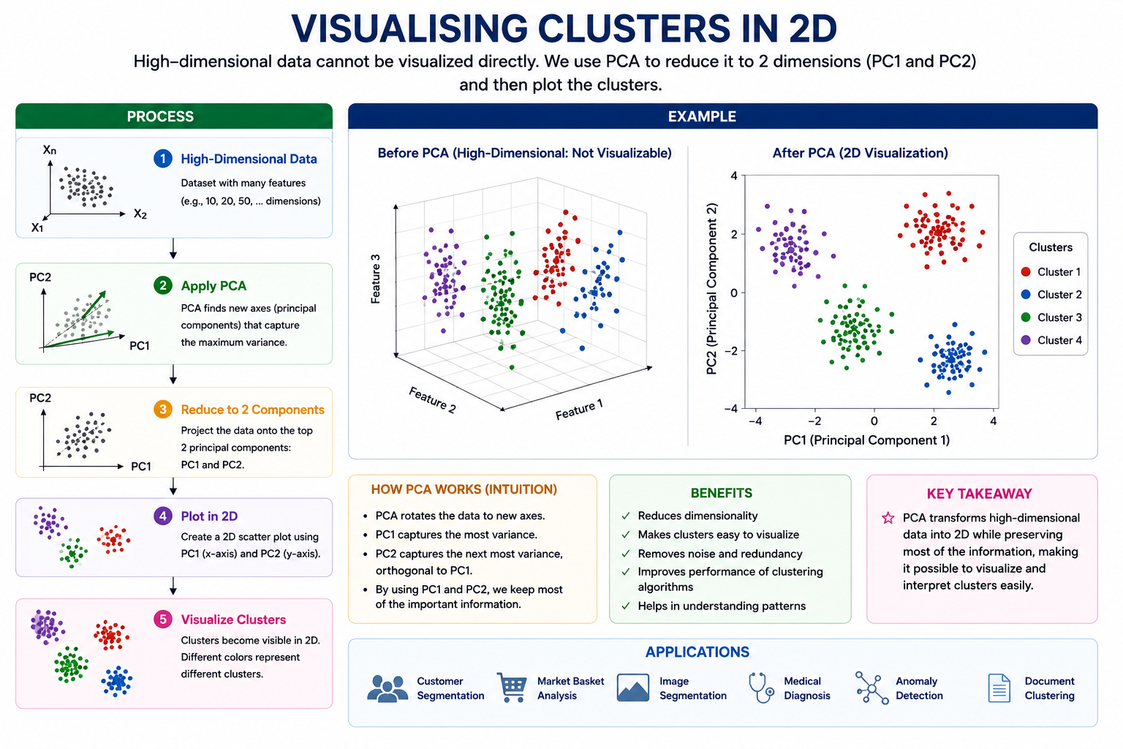
CLUSTERING & DIMENSIONALITY REDUCTION

Slide 28
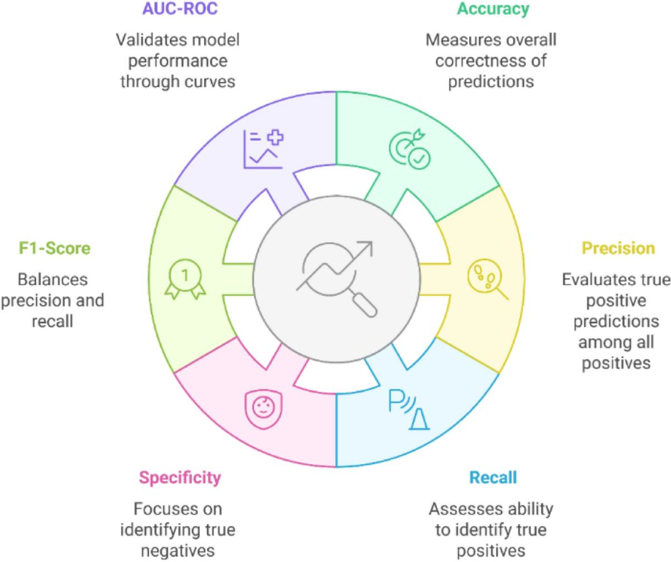
MODEL EVALUATION & HYPERPARAMETER TUNING
Classification metrics:
What are Evaluation Metrics?
Evaluation metrics measure how well a machine learning model performs on unseen data.
Why are they Important?
Measure prediction accuracy.
Compare different models.
Identify model strengths and weaknesses.
Help improve decision making.
Common Metrics
Precision
Recall
F1-Score
ROC Curve
AUC Score

Slide 29
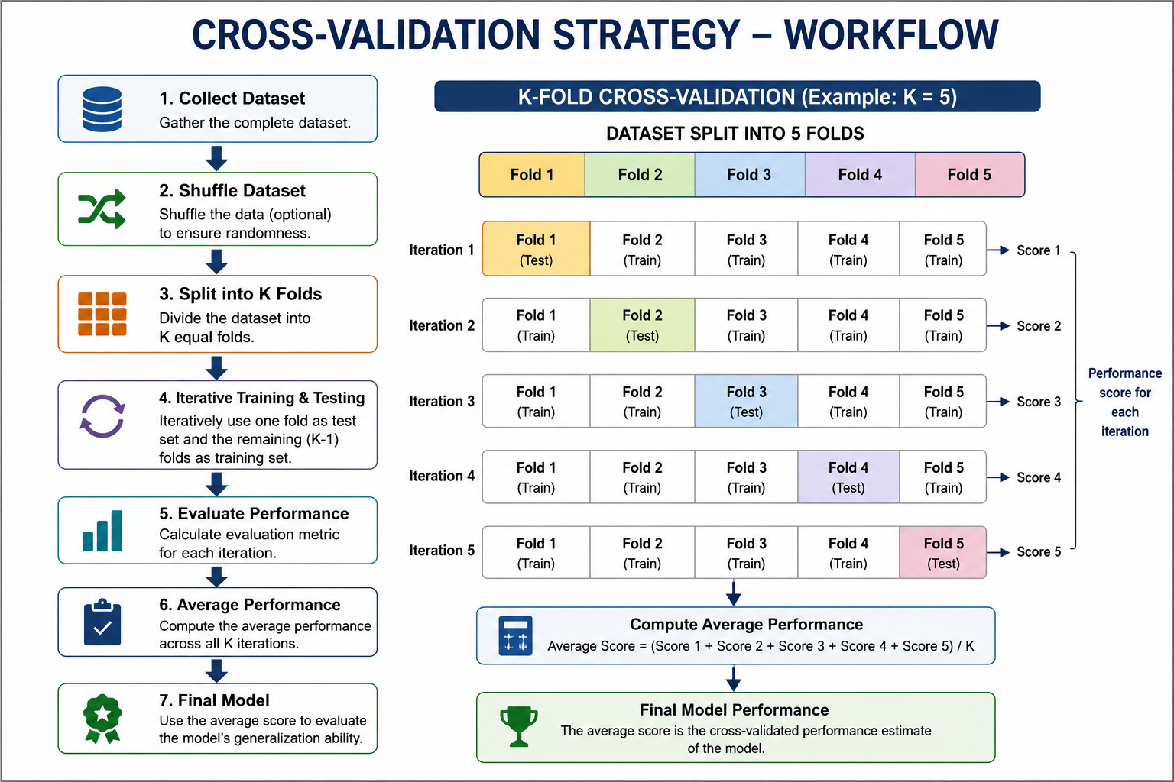
MODEL EVALUATION & HYPERPARAMETER TUNING
Cross-Validation Strategies
Cross-validation is a model evaluation technique used to assess how well a machine learning model will perform on unseen data. It helps estimate the model's generalization ability and reduces the risk of overfitting.
K-Fold Cross-Validation
The standard go-to strategy. The dataset is randomly split into K equal-sized folds. The model is trained K times, each time using K-1 folds for training and the remaining fold for testing. The final performance score is the average of the K runs.

Slide 30
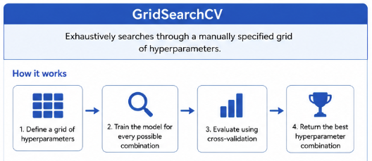
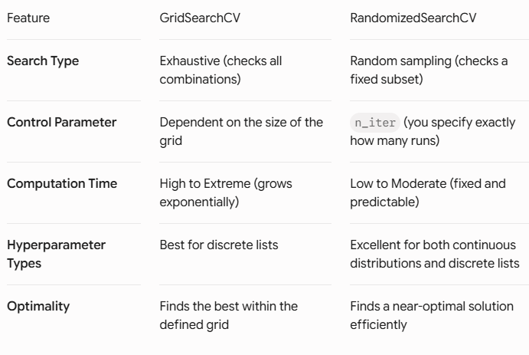
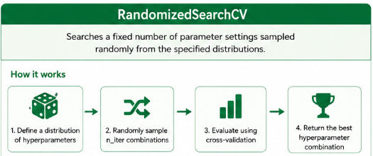
MODEL EVALUATION & HYPERPARAMETER TUNING
Both GridSearchCV and RandomizedSearchCV are hyperparameter tuning techniques used in machine learning to find the optimal combination of parameters for a given model.
KEY DIFFERENCES

Slide 31
MODEL EVALUATION & HYPERPARAMETER TUNING
The bias–variance tradeoff is a fundamental concept in machine learning that describes the balance between two sources of prediction error:
2. Variance
Variance is the error caused by the model being too sensitive to the training data.
High variance → model is too complex.
It learns noise and random fluctuations in the training set.
Leads to overfitting.
Example:
A very deep decision tree that memorizes training examples.
1. Bias
Bias is the error caused by overly simplistic assumptions in the model.
High bias → model is too simple.
It fails to capture the true patterns in the data.
Leads to underfitting.
Example:
Using a straight line to model a highly curved relationship.
Error Decomposition
For many learning problems:
Where:
Bias²: error from wrong assumptions.
Variance: error from sensitivity to data fluctuations.
Irreducible error: noise inherent in the data.

Slide 32
FEATURE ENGINEERING & PIPELINES
Feature Selection: Feature selection is the process of choosing the most relevant input features (variables) for building a machine learning model. It improves model performance, reduces overfitting, and decreases training time.
SelectKBest
Definition: SelectKBest selects the top K features based on a statistical test.
How it Works
Calculate a score for every feature.
Rank the features.
Select the top K highest-scoring features.
Train the model using only these selected features.
Recursive Feature Elimination (RFE)
Definition: RFE recursively removes the least important features until the desired number of features remains.
How it Works
Train a model.
Calculate feature importance.
Remove the least important feature.
Retrain the model.
Repeat until the required number of features remains.
Correlation-Based Feature Selection
Definition: Correlation measures how strongly two variables are related.
Highly correlated features contain similar information. One of them can often be removed.
Correlation Values
+1 | Perfect positive correlation
0 | No correlation

Slide 33
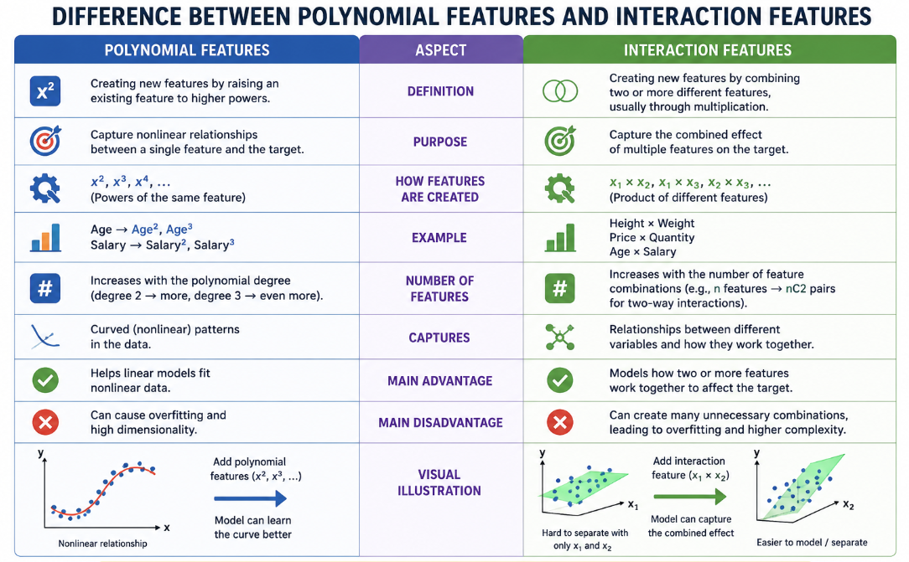
FEATURE ENGINEERING & PIPELINES
Creating New Features (Polynomial and Interaction Features)
Feature engineering is the process of creating new features (variables) from existing data to improve the performance of a machine learning model. Well-designed features help models capture patterns that may not be apparent from the original data.

Slide 34
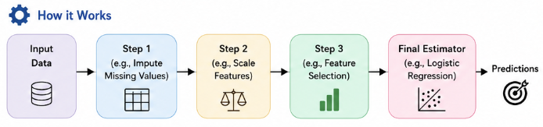
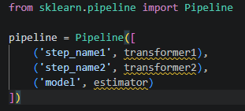
FEATURE ENGINEERING & PIPELINES
Scikit-learn Pipeline to Chain Steps
What is a Scikit-learn Pipeline?
A Pipeline in scikit-learn is a utility that allows you to combine multiple preprocessing steps and a machine learning model into a single object. Each step is executed sequentially, ensuring that the exact same preprocessing is applied during both training and testing.
Syntax:

Slide 35
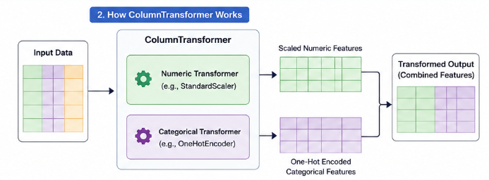
FEATURE ENGINEERING & PIPELINES
Column Transformer for Mixed Data Types (Scikit-learn)
What is ColumnTransformer?
A ColumnTransformer in scikit-learn is a preprocessing tool that allows you to apply different transformations to different columns of a dataset.
It is especially useful when your dataset contains mixed data types, such as:
Numerical features (Age, Salary)
Categorical features (Gender, City)
Text features (Reviews)
Date/Time features
Instead of applying the same preprocessing to every column, ColumnTransformer applies the appropriate preprocessing to each type.

Slide 36
Introduction to NLP
Natural Language Processing (NLP) is a branch of Artificial Intelligence that enables computers to understand, interpret, process, and generate human language in both text and speech forms.
In simple words, NLP helps computers communicate with humans using natural language, such as English, Hindi, or any other language.
Key Points
Converts human language into a format that computers can understand.
Combines Artificial Intelligence, Machine Learning, and Linguistics.
Used for analyzing, understanding, translating, and generating text or speech.
Examples of NLP Applications
Chatbots and virtual assistants
Language translation
Sentiment analysis
Spam email detection
Text summarization
Speech recognition
Question answering systems

Slide 37
INTRODUCTION TO NLP
Text Preprocessing
Definition: Text preprocessing is the process of cleaning and transforming raw text into a format suitable for machine learning models.
Steps in Text Preprocessing
A. Tokenization
Definition: Breaking text into smaller units called tokens (words or sentences).
Example:
Sentence: "I love Machine Learning!"
Tokens:
["I", "love", "Machine", "Learning"]
B. Stopwords Removal
Definition: Stopwords are commonly used words that usually do not add much meaning.
Examples:
is, am, are, the, a, an, in, on, of, to
Example:
Original:
The cat is sleeping on the mat.
After removing stopwords:
cat sleeping mat
C. Stemming
Definition: Reduces words to their root (stem) form.
Examples:
Original Word | Stem
Playing | Play
Played | Play
Playing | Play
Studies | Studi
Running | Run

Slide 38
Bag of Words (BoW)
Bag of Words (BoW) is a text vectorization technique that converts text into numerical feature vectors by counting how many times each word appears in a document. It ignores grammar and word order but preserves word frequency.
2. TF-IDF Vectorization
TF-IDF (Term Frequency–Inverse Document Frequency) is a feature extraction technique that measures the importance of a word in a document relative to a collection of documents.
Formula
Working Steps
Collect all documents.
Create a vocabulary of unique words.
Count the frequency of each word in every document.
Represent each document as a numerical vector.
(Number of times a word appears in a document)
TF = ------------------------------------------------------------------
Total number of words in the document
Advantages
Simple and easy to implement.
Works well for basic text classification.
Fast computation.
Disadvantages
Ignores word order.
Large vocabulary increases dimensionality.
Treats all words as equally important.
Advantages
Gives more importance to meaningful words.
Reduces the impact of common words.
Improves classification accuracy.
Disadvantages
More computationally expensive than BoW.
Does not capture word meaning or context.

Slide 39
3. Naive Bayes Text Classifier
A Naive Bayes classifier is a probabilistic machine learning algorithm based on Bayes' Theorem. It is widely used for text classification because it is fast, simple, and effective.
4. Sentiment Analysis Basics
Sentiment Analysis is an NLP technique used to determine the emotional tone or opinion expressed in text.
Workflow
Workflow
Input Text
↓
Text Preprocessing
↓
BoW / TF-IDF Vectorization
↓
Naive Bayes Classifier
↓
Predicted Category
Text Input
↓
Text Preprocessing
↓
Feature Extraction (BoW / TF-IDF)
↓
Machine Learning Model
↓
Positive / Negative / Neutral
Advantages
Fast training and prediction.
Performs well on high-dimensional text data.
Works well with small datasets.
Limitations
Assumes all features are independent.
May perform poorly when features are strongly related.
Advantages
Understands customer opinions.
Helps businesses improve products and services.
Supports decision-making using customer feedback.
Struggles with negation words such as "not" and "never".
Has difficulty handling mixed or conflicting sentiments
Cannot accurately detect sarcasm or irony.
Limitations

Slide 40
MACHINE LEARNING CAPSTONE
An End-to-End Machine Learning Project Workflow is the complete process of solving a real-world problem using Machine Learning, from understanding the problem to deploying the model.
WORKFLOW
Problem Definition
↓
Data Collection
↓
Data Understanding (EDA)
↓
Data Preprocessing
↓
Feature Engineering
↓
Train-Test Split
↓
Model Selection
↓
Model Training
↓
Model Evaluation
↓
Hyperparameter Tuning
↓
Model Saving
↓
Deployment
↓
Monitoring & Maintenance

Slide 41
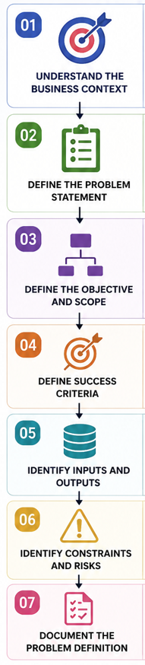
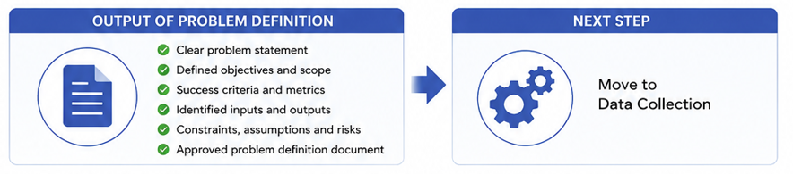
MACHINE LEARNING CAPSTONE
Problem: A poorly defined problem leads to a beautifully engineered model that solves the wrong thing. Defining a problem requires translating a vague real-world objective into a concrete machine learning task.
Objective: Clearly define what you want the model to predict.

Slide 42
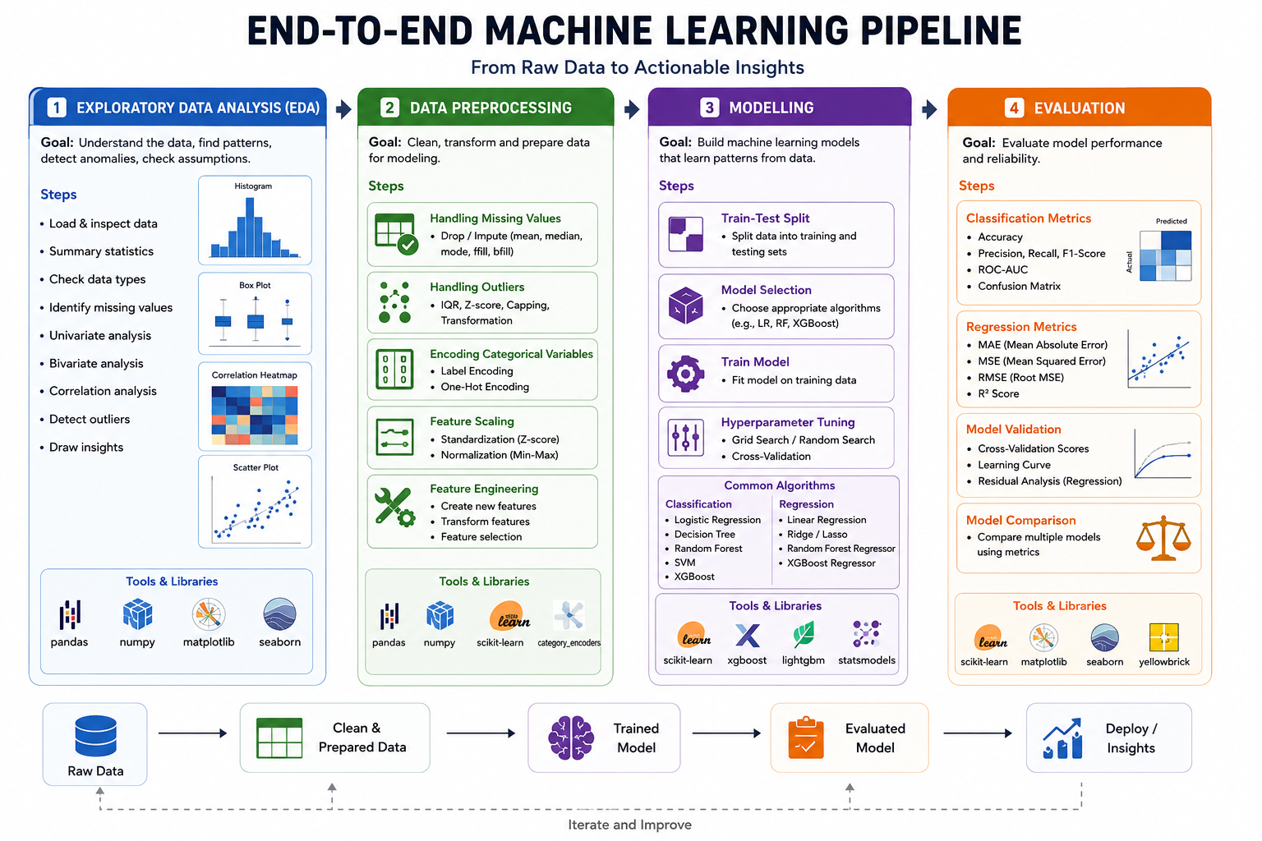

Slide 43
Reporting Results with Visualisations
Reporting Results with Visualisations is the final stage of a Machine Learning project where you communicate the
performance of your model and the insights gained from the data. A good report should answer:
How well does the model perform?
Which features influence the prediction the most?
What patterns exist in the data?
Can stakeholders trust the model?
What improvements are possible?
The goal is to present complex ML results in a simple, visual, and understandable way.
ML Reporting Workflow
Train Model
│
▼
Make Predictions
│
▼
Calculate Performance Metrics
│
▼
Create Visualisations
│
▼
Interpret Results
│
▼
Write Conclusions
│
▼
Suggest Improvements

Slide 44
REFERENCES
Google ML Crash Course
Scikit-learn
Kaggle
StatQuest
NLTK Official Docs
Towards Data Science – ML Projects

